Slide 1

Group 3
Elliot Chester, Adam Speers, Matt Fisher, Lenneth Dayaon

Slide 2
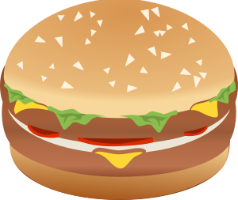
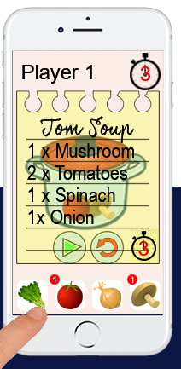
Core mechanics
2D Cooking Game
Symmetrical
Turn Based Competitive
Cognitive Memory Gameplay
Notes:
This will include our prototype and just a few words to describe it

Slide 3

Current state
Ingredients
Players Look at the recipe
Player 1 selects ingredients
Player 2 Selects ingredients

Slide 4
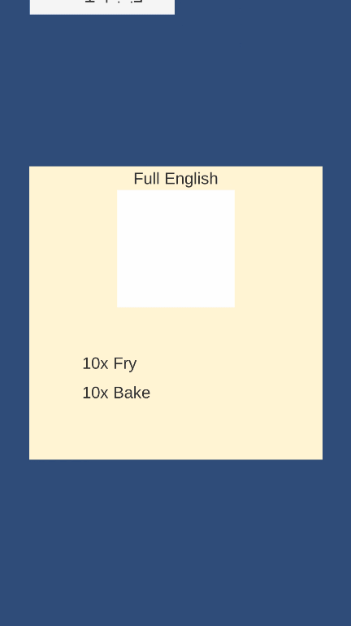
Current state
Cooking
Players memorise cooking steps
Players take turns tapping
Results screen show the players scores

Slide 5
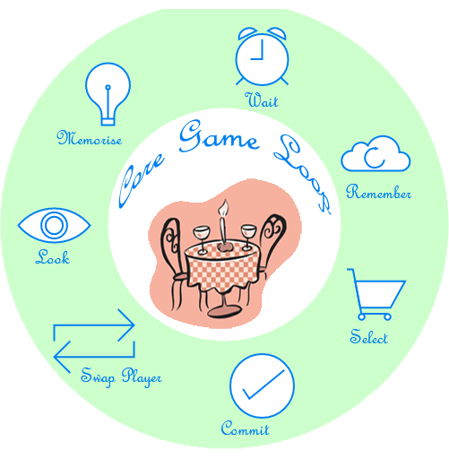
Core game loop

Slide 6

How we will iterate our game based on feedback
Its too easy
Player 2 can’t read the recipe
It’s not clear who’s winning
Notes:
Feedback from play testers, what to add, what to take away

Slide 7
How we will iterate our game based on feedback
Its too easy
We will add a red herring
Player 2 can’t read the recipe
It’s not clear who’s winning
Notes:
Feedback from play testers, what to add, what to take away

Slide 8
How we will iterate our game based on feedback
Its too easy
We will add a red herring
Player 2 can’t read the recipe
We will Flip the recipe card for player 2
It’s not clear who’s winning
Notes:
Feedback from play testers, what to add, what to take away

Slide 9
How we will iterate our game based on feedback
Its too easy
We will add a red herring
Player 2 can’t read the recipe
We will Flip the recipe card for player 2
It’s not clear who’s winning
Each player has a couple to make happy
Notes:
Feedback from play testers, what to add, what to take away

Slide 10

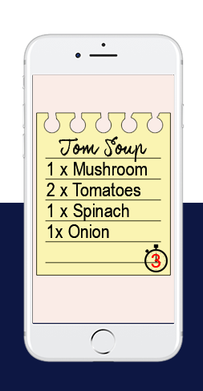
Demonstration of Fun in our game
Hard Fun
Mastery
People Fun
Schadenfreude
Stroop effect
Notes:
Maybe have videos/ pictures of player wins and player interaction
Describe them

Slide 11
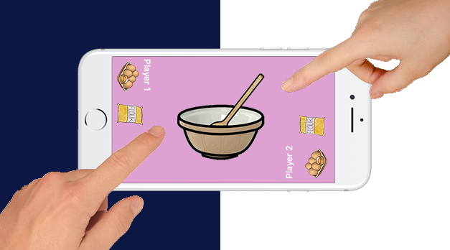
Demonstration of Fun in our game
Hard Fun
People Fun
Play with friends
Schadenfreude
Stroop effect
Notes:
Maybe have videos/ pictures of player wins and player interaction
Describe them

Slide 12
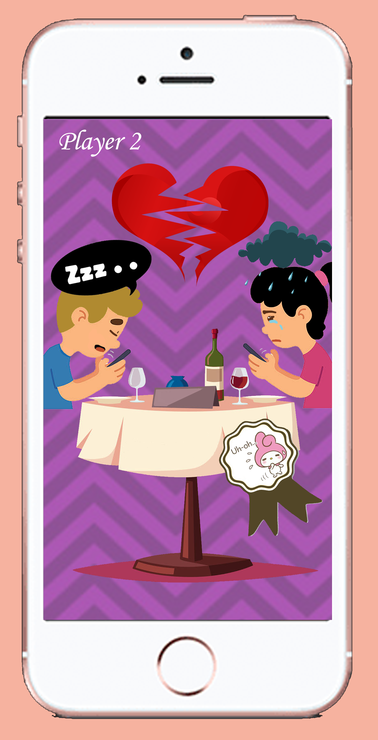
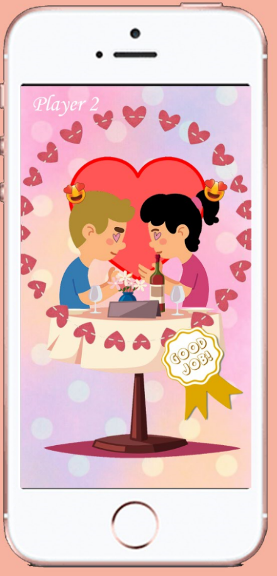
Demonstration of Fun in our game
Hard Fun
People Fun
Schadenfreude
Beat your opponent
Stroop effect
Notes:
Maybe have videos/ pictures of player wins and player interaction
Describe them

Slide 13
Demonstration of Fun in our game
Hard Fun
People Fun
Schadenfreude
Stroop effect
Given Text, Tap Pictures
Notes:
Maybe have videos/ pictures of player wins and player interaction
Describe them

Slide 14

What features our game will have
Phonological Loop
Short term store
Articulatory Rehearsal Process
7 +/- 2
Intermediate Term Memory
Timed To Add Pressure

Slide 15
Any Questions?

